Slide 1
Principles of Programming Languages (MCT542 )
Computer Application Department,
RCOEM

Slide 2
Syllabus (MCA SEM- V)
Course Code: MCT542
Courses: Principles of Programming Languages
L:3 Hrs, P: 0 Hrs, Per week
Total Credits: 3

Slide 3
Section-II Weightage - 35%, Minimum Teaching Hours - 11 )
Control Flow:
Expression evaluation , Assignment statements, Short-Circuit of expression evaluation , Selection statements , Case statements, Jump table, Iteration, Enumerated loops, While loop, C for loop, do-while loop, Activation Record format, Tail recursion, Thinking Recursively.

Slide 4
Section-II Weightage - 35%, Minimum Teaching Hours - 11 )
Data Types
Data Types, Numeric types, Implementations of int, float, bool, char, enum, subranges, Type equivalence, type conversion, coercion, type safety, Records, packed and unpacked implementations, Variant Records, Arrays, Row major allocation, Address calculation, Row/Column major allocation method impact, Row-pointer layout, Address calculation of row-pointer layout, Generation of code for array access, Stack Smashing due to lack of bound checks, Pointers, Recursive Data types, Tombstones/Lock and Key for Dangling Reference.

Slide 5
Control Flow
Ordering and control flow is fundamental to most models of computing. It determines what should be done first, what second, and so forth, to accomplish some desired task.
We can organize the language mechanisms used to specify ordering into eight principal categories
Sequencing:
Selection:
Iteration:
Procedural abstraction
Recursion:
Concurrency:
Exception handling and speculation:
Nondeterminacy:

Slide 6
Control Flow
Expression Evaluation
An expression generally consists of either a simple object or an operator or function applied to a collection of operands or arguments, each of which in turn is an expression.
In most imperative languages, function calls consist of a function name followed by a parenthesized, comma-separated list of arguments, as in
my_func(A, B, C)
Operators are typically simpler, taking only one or two arguments, and dispensing with the parentheses and commas:
a + b
- c

Slide 7
Control Flow
In general, a language may specify that function calls (operator invocations) employ prefix, infix, or postfix notation.
prefix: op a b or op (a, b) or (op a b)
infix: a op b
postfix: a b op
Most imperative languages use infix notation for binary operators and prefix notation for unary operators and (with parentheses around the arguments) other functions
Few languages, notably ML and the R scripting language, allow the user to create new infix operators. Smalltalk uses infix notation for all functions (which it callsmessages), both built-in and user-defined.

Slide 8
Control Flow
1. Precedence and Associativity
Most languages provide a rich set of built-in arithmetic and logical operators. When written in infix notation, without parentheses, these operators lead to ambiguity as to what is an operand of what.
For example, In Fortran which uses ** for exponentiation, how should we parse a + b * c**d**e/f? Should this be grouped as
((((a + b) * c)**d)**e)/f
or
a + (((b * c)**d)**(e/f))
or
a + ((b * (c**(d**e)))/f)

Slide 9
Control Flow
In any given language, the choice among alternative evaluation orders depends on the precedence and associativity of operators,
Precedence rules specify that certain operators, in the absence of parentheses, group “more tightly” than other operators. In most languages multiplication and division group more tightly than addition and subtraction, so 2 + 3 × 4 is 14 and not 20.
The intent of the language designers was presumably to ensure that “the right thing” will usually happen when parentheses are not used to force a particular evaluation order.

Slide 10
Control Flow
ssfs

Slide 11
Control Flow
Associativity rules specify whether sequences of operators of equal precedence group to the right or to the left.
Conventions here are somewhat more uniform across languages, but still display some variety. The basic arithmetic operators almost always associate left-to-right, so 9 - 3 - 2 is 4 and not 8.
In Fortran, as noted above, the exponentiation operator (**) follows standard mathematical convention, and associates right-to-left, so 4**3**2 is 262144 and not 4096

Slide 12
Control Flow
Because the rules for precedence and associativity vary so much from one language to another, a programmer who works in several languages is wise to make liberal use of parentheses.

Slide 13
Assignment Statement
Value model and Reference model

Slide 14
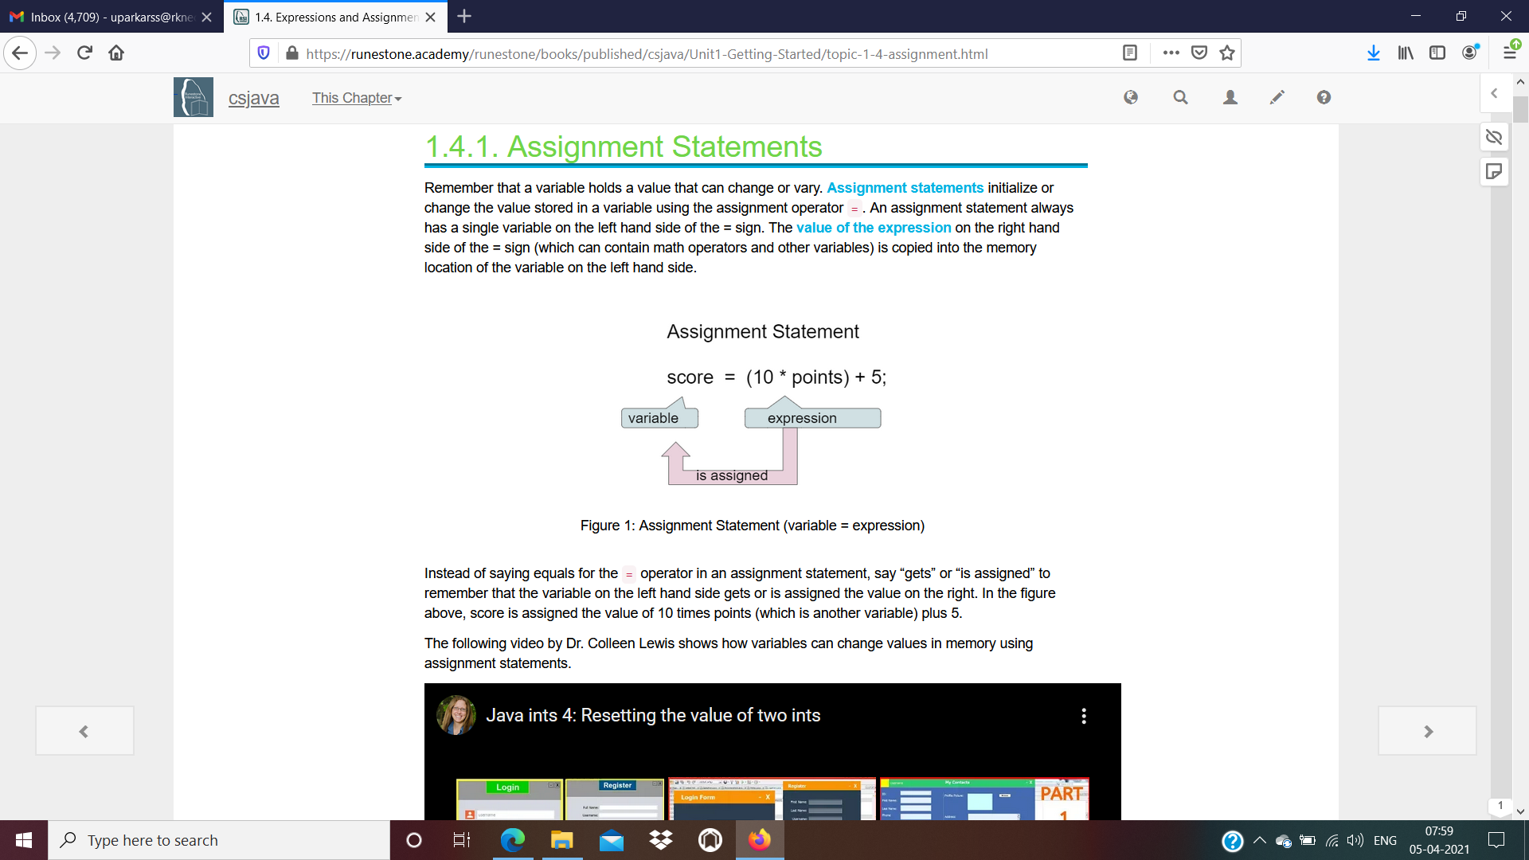
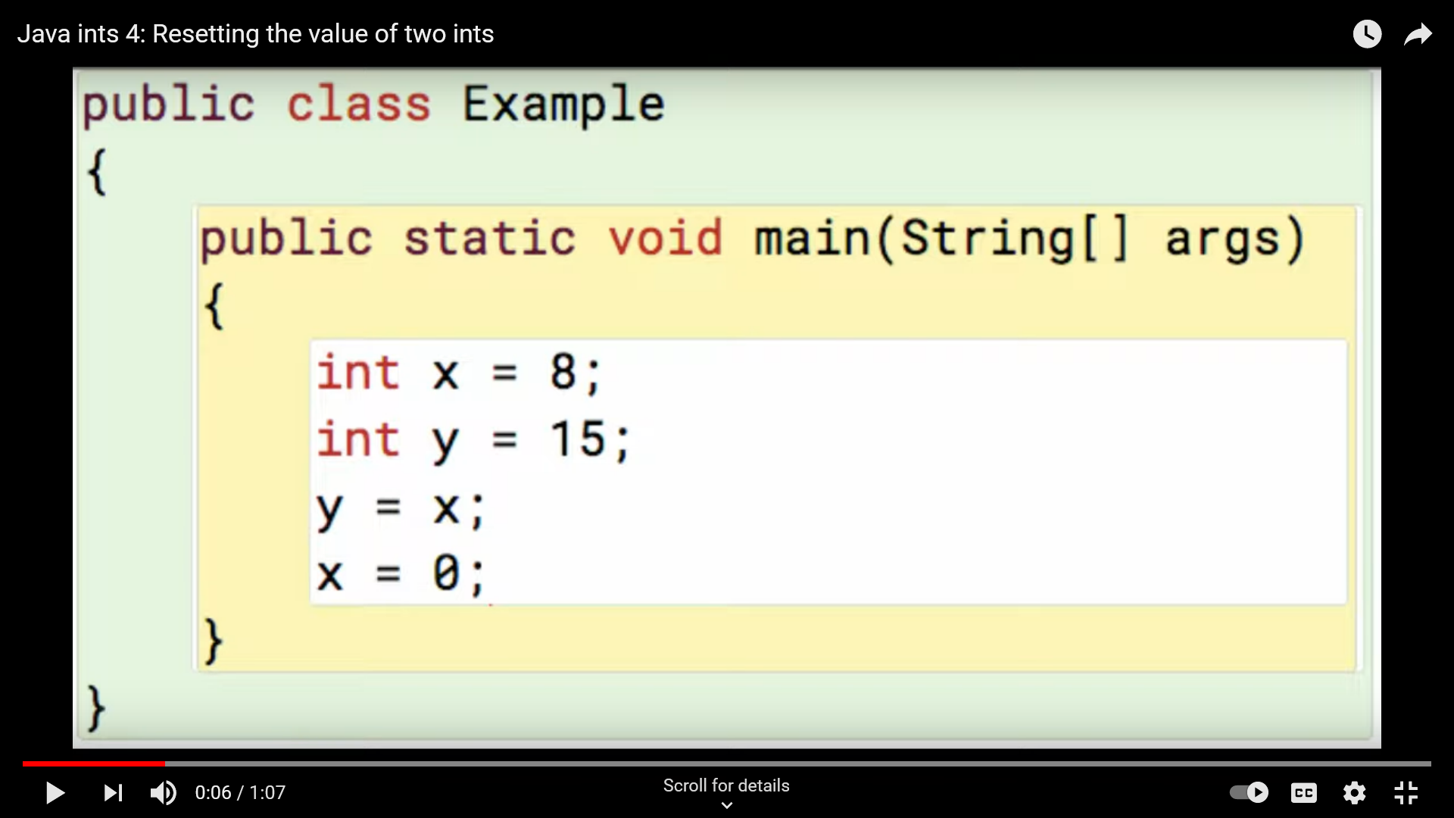
Each assignment takes a pair of arguments: a value and a reference to a variable into which the value should be placed.
ML and Lisp are mostly functional, but make assignment available to programmers who want it.
main
x=8
y=15
y=8
x=0
Note : value of y donot change
Issue: is assignment an expression or a statement?

Slide 15
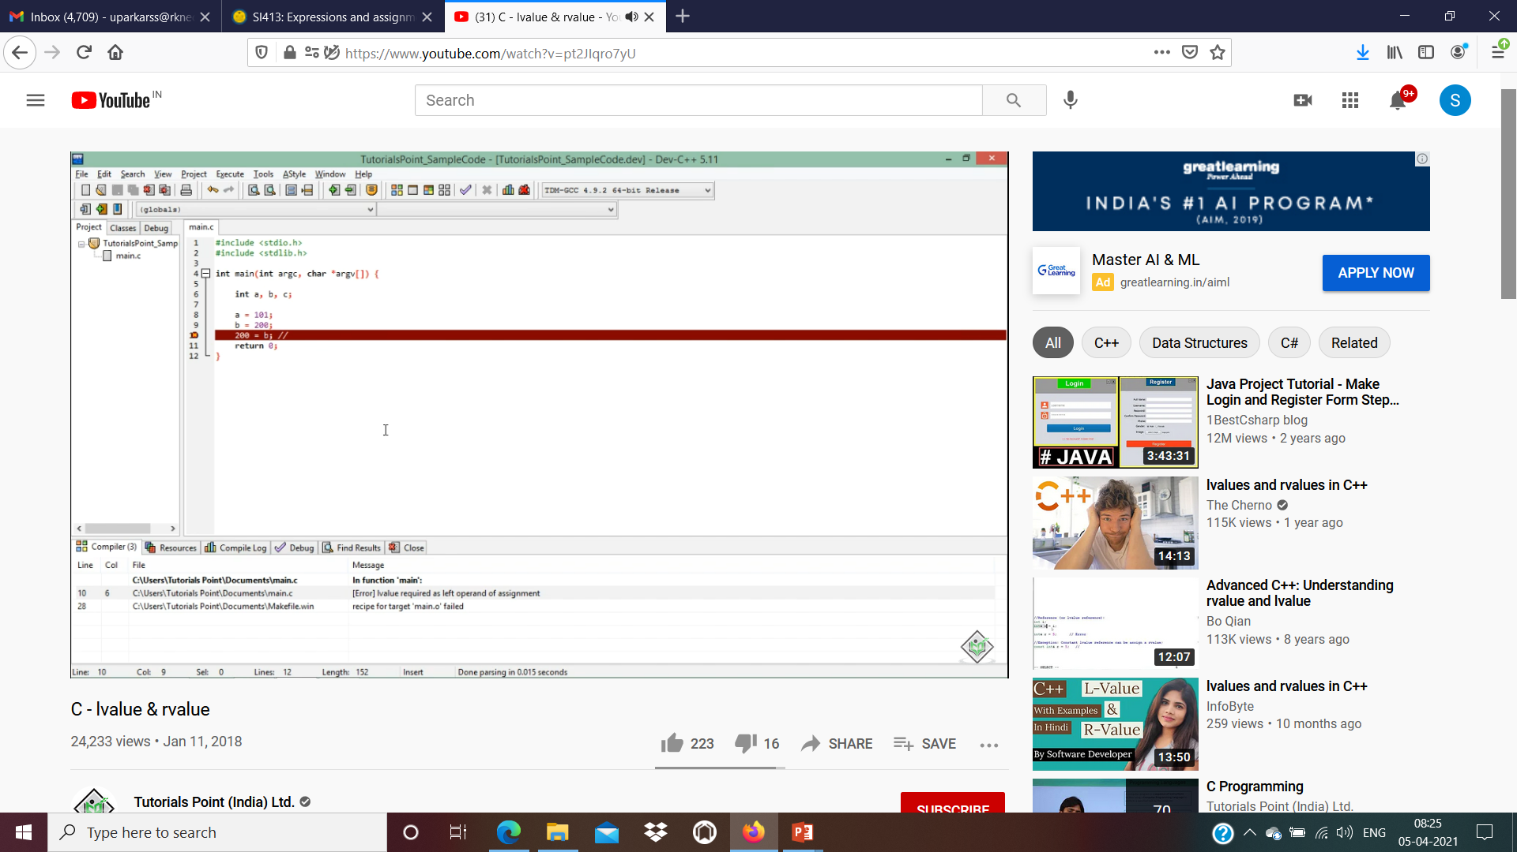

Slide 16
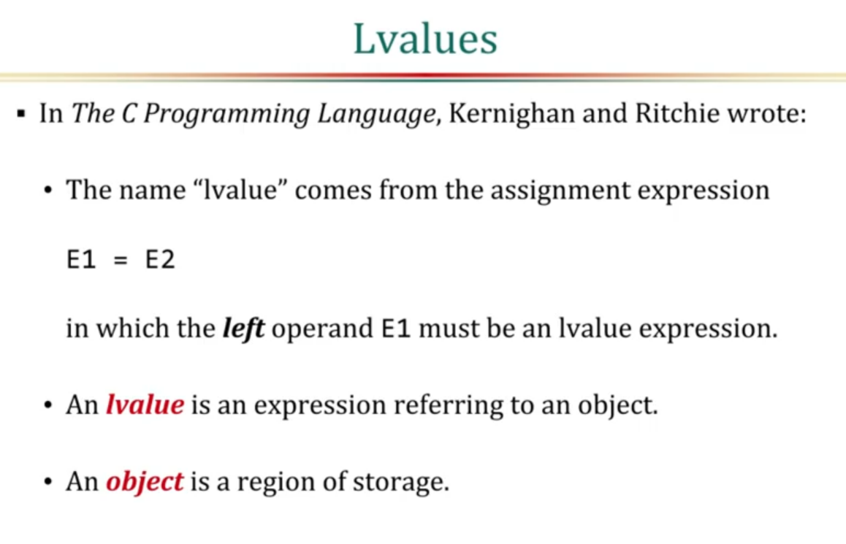

Slide 17
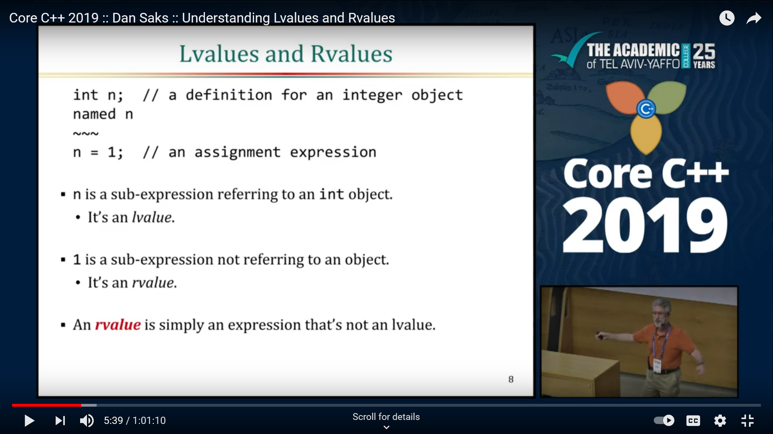
Lvalue and Rvalue

Slide 18
Multiway Assignment
In several languages, including Clu, ML, Perl, Python, and Ruby, it is also possible to write
a, b = c, d;
Here the comma in the right-hand side is not the sequencing operator of C. Rather, it serves to define a expression, or tuple, consisting of multiple r-values. The comma operator on the left-hand side produces a tuple of l-values. The effect of the assignment is to copy c into a and d into b. While we could just as easily have written
a = c; b = d;

Slide 19
3. Initialization
It should be emphasized that initialization saves time only for variables that are statically allocated. Variables allocated in the stack or heap at run time must be initialized at run time.
If a variable is not given an initial value explicitly in its declaration, the language may specify a default value.
In C, for example, statically allocated variables for which the programmer does not provide an initial value are guaranteed to be represented in memory as if they had been initialized to zero.

Slide 20
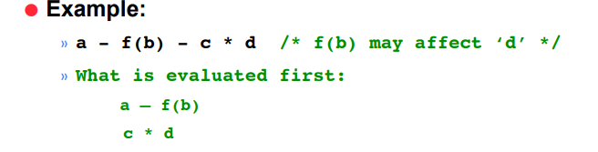
4. Ordering within Expressions
While precedence and associativity rules define the order in which binary infix operators are applied within an expression, they do not specify the order in which the operands of a given operator are evaluated.
There are two main reasons why the order can be important: Side effects and Code improvement

Slide 21
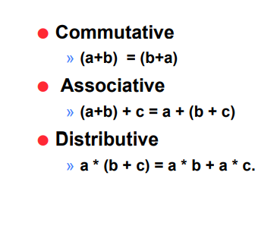
Applying Mathematical Identities
Some language implementations (e.g., for dialects of Fortran) allow the compiler to rearrange expressions involving operators whose mathematical abstractions are commutative, associative, and/or distributive, in order to generate faster code.

Slide 22
Example of reordering using Mathematical identities
Consider the following Fortran fragment:
a = b + c
d = c + e + b
Some compilers will rearrange this as
a = b + c
d = b + c + e
They can then recognize the common subexpression in the first and second statements, and generate code equivalent to
a = b + c
d = a + e

Slide 23
Control Flow
5. Short-Circuit Evaluation
Consider the expression (a < b) and (b < c). If a is greater than b, there is really no point in checking to see whether b is less than c; we know the overall expression must be false.
Similarly, in the expression (a > b) or (b > c), if a is indeed greater than b there is no point in checking to see whether b is greater than c; we know the overall expression must be true.
A compiler that performs short-circuit evaluation of Boolean expressions will generate code that skips the second half of both of these computations when the overall value can be determined from the first half.

Slide 24
Control Flow
Short-circuit evaluation can also be used to avoid out-of-bound subscripts:
const MAX = 10;
int A[MAX]; /* indices from 0 to 9 */
...
if (i >= 0 && i < MAX && A[i] > foo) ...
division by zero:
if (d <> 0 && n/d > threshold) ...
and various other errors

Slide 25
Control Flow
A few languages provide both regular and short-circuit Boolean operators. In Ada, for example, the regular Boolean operators are and and or; the short-circuit operators are the two-word operators and then and or else:
When used to determine the flowof control in a selection or iteration construct, short-circuit Boolean expressions do not really have to calculate a Boolean value; they simply have to ensure that control takes the proper path in any given situation.

Slide 26
Control Flow
Structured and Unstructured Flow
Control flow in assembly languages is achieved by means of conditional and unconditional jumps (branches).
Early versions of Fortran mimicked the low level approach by relying heavily on goto statements for most nonprocedural control flow:
if (A .lt. B) goto 10 ! ".lt." means "<"
...
10
Ex: Control flow with gotos in Fortran
The 10 on the bottom line is a statement label. Goto statements also featured prominently in other early imperative languages.

Slide 27
Control Flow
Ada and C# allow gotos only in limited contexts. Clu, Eiffel, Java, and most of the scripting languages do not allow them at all.
Fortran 90 and C++ allow them primarily for compatibility with their predecessor languages.
(Java reserves the token goto as a keyword, to make it easier for a Java compiler to produce good error messages when a programmer uses a C++ goto by mistake.)

Slide 28
Control Flow
Many of the structured control-flow constructs familiar to modern programmers were pioneered by Algol 60.
In Algo 60 include the if. . . then . . . else construct and both enumeration (for) and logically (while) controlled loops.
The modern case (switch) statement was introduced by Wirth and Hoare in AlgolW[WH66] as an alternative to the more unstructured computed goto and switch constructs of Fortran and Algol 60, respectively.

Slide 29
Control Flow
Continuations (Continue / CC/ Call)
The notion of nonlocal gotos that unwind the stack can be generalized by defining what are known as continuations.
In low-level terms, a continuation consists of a code address and a referencing environment to be restored when jumping to that address.
Continuations are an extremely powerful facility. They can be very useful if applied in well-structured ways (i.e., to define new control-flow constructs).
Unfortunately, they also allow the undisciplined programmer to construct completely inscrutable programs.

Slide 30
Control Flow
Selection
Selection statements in most imperative languages employ some variant of the if. . . then . . . else notation introduced in Algol 60:
if condition then statement
else if condition then statement
else if condition then statement
...
else statement

Slide 31
Control Flow
Short-Circuited Conditions
Short-circuiting is where an expression is stopped being evaluated as soon as its outcome is determined
While the condition in an if. . . then . . . else statement is a Boolean expression, there is usually no need for evaluation of that expression to result in a Boolean value in a register.
Most machines provide conditional branch instructions that capture simple comparisons. Put another way, the purpose of the Boolean expression in a selection statement is not to compute a value to be stored, but to cause control to branch to various locations.
This observation allows us to generate particularly efficient code (called jump code) for expressions that are amenable to the short-circuit evaluation

Slide 32
Control Flow
Example:
In any programming language that implements short-circuit evaluation, the expression x and y is equivalent to the conditional expression if x then y else x, and the expression x or y is equivalent to if x then x else y. In either case, x is only evaluated once.
The generalized definition above accommodates loosely typed languages that have more than the two truth-values True and False, where short-circuit operators may return the last evaluated subexpression. This is called "last value" in the table below

Slide 33
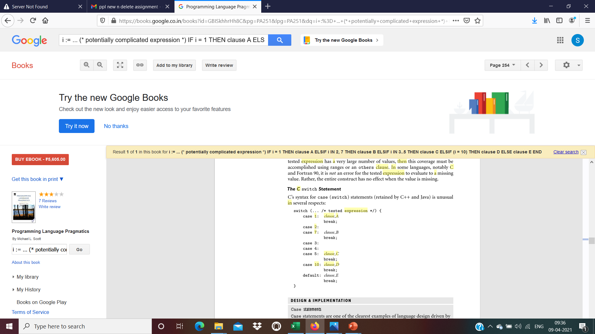
Control Flow
Case/Switch Statements
When each condition compares the same integer expression to a different compile-time constant, then the following code
i := ... (* potentially complicated expression *)
IF i = 1 THEN
clause A
ELSIF i IN 2, 7 THEN
clause B
ELSIF i IN 3..5 THEN
clause C
ELSIF (i = 10) THEN
clause D
ELSE
clause E
END

Slide 34
Control Flow
can be rewritten as
CASE ... (* potentially complicated expression *) OF
1: clause A
| 2, 7: clause B
| 3..5: clause C
| 10: clause D
ELSE clause E
END
The elided code fragments (clause A, clause B, etc.) after the colons and the ELSE are called the arms of the CASE statement. The lists of constants in front of the colons are CASE statement labels.

Slide 35
Control Flow
Most languages allow this type to be anything whose values are discrete: integers, characters, enumerations, and subranges of the same. C# allows strings as well.
The CASE statement version of the code above is certainly less verbose than the
IF. . . THEN . . . ELSE version, but syntactic elegance is not the principal motivation for providing a CASE statement in a programming language. The principal motivation is to facilitate the generation of efficient target code.

Slide 36
Control Flow
Alternative Implementations ( jump table )
A linear jump table is fast. It is also space efficient when the overall set of case statement labels is dense and does not contain large ranges.
It can consume an extraordinarily large amount of space, however, if the set of labels is non dense, or includes large value ranges.
In C , a jump table is a special array of pointer-to-functions.

Slide 37
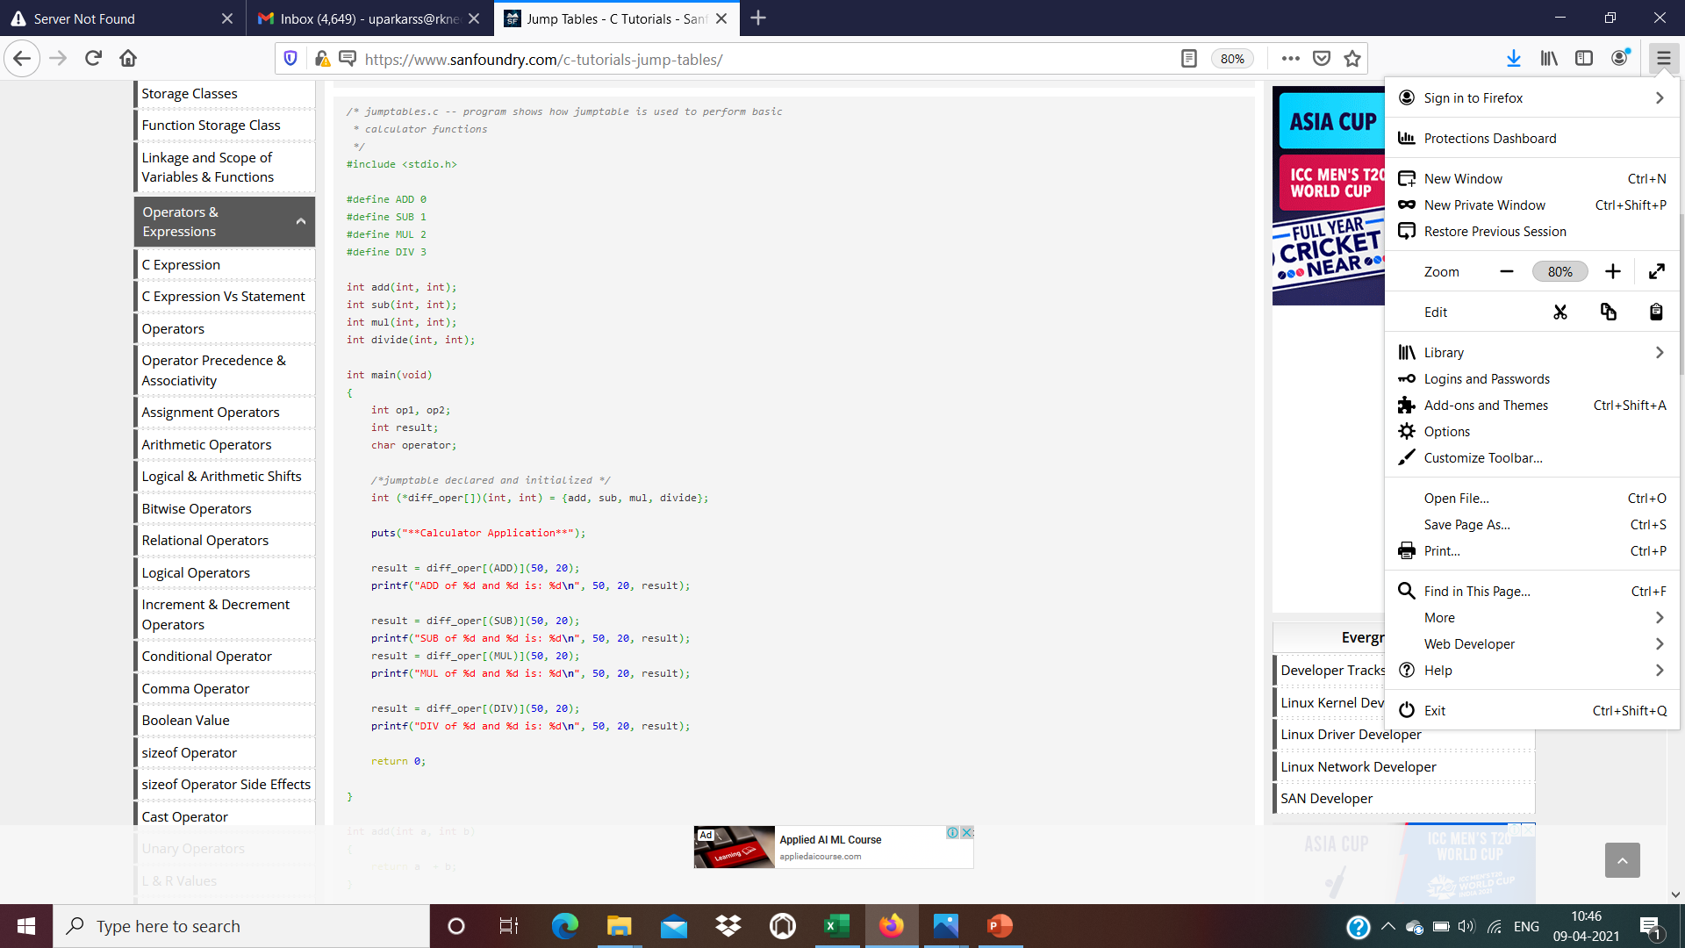
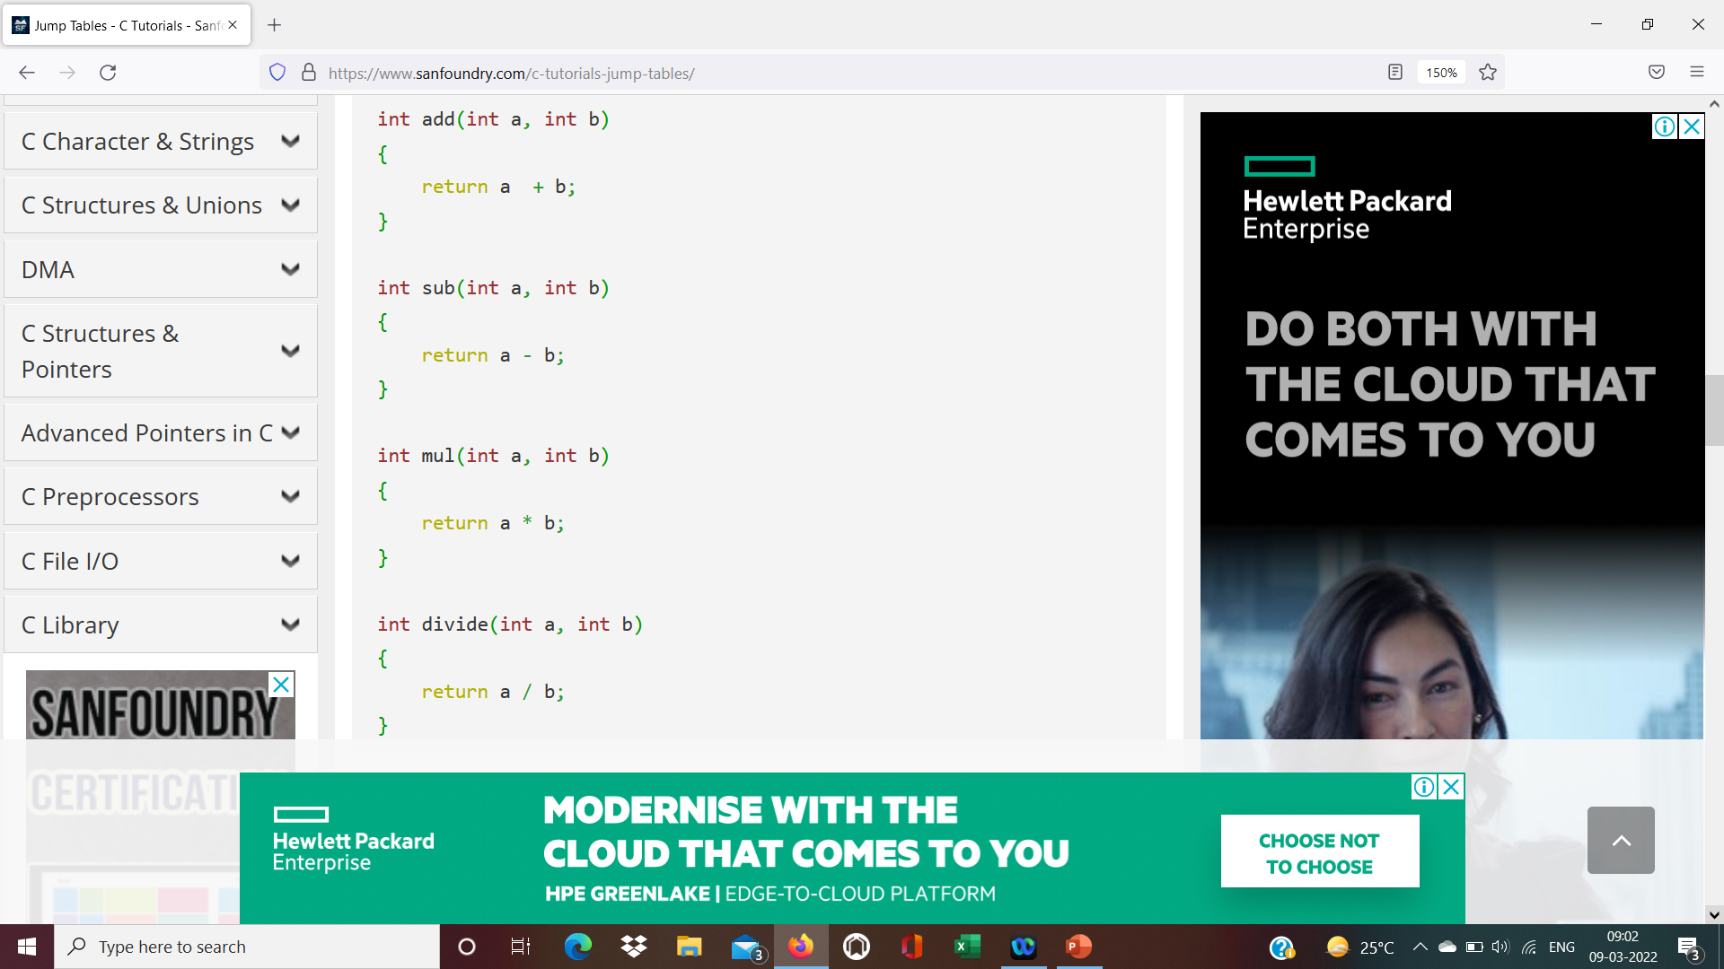
Control Flow
In C , a jump table is a special array of pointer-to-functions.

Slide 38
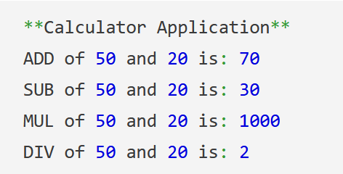
Output :

Slide 39
Control Flow
Case/Switch Statements
When each condition compares the same integer expression to a different compile-time constant,

Slide 40
Control Flow
The principal motivation is to facilitate the generation of efficient target code.
During compilation it can generate code for the various arms of the case statement as it finds them, while simultaneously building up an internal data structure to describe the label set. Once it has seen all the arms, it can decide which form of target code to generate.
Many use binary search in lieu of hashing Some generate only indexed jump tables; others only that plus sequential testing.

Slide 41
Control Flow
Syntax and Label Semantics
As with if. . . then . . . else statements, the syntactic details of case statements vary from language to language.
Different languages use different punctuation to delimit labels and arms.
Standard Pascal does not permit a default clause: all values on which to take action must appear explicitly in label lists.
In some languages, notably C and Fortran 90, it is not an error for the tested expression to evaluate to a missing value. Rather, the entire construct has no effect when the value is missing.

Slide 42
Control Flow
s

Slide 43
Control Flow
Iteration:
Iteration and recursion are the two mechanisms that allow a computer to perform similar operations repeatedly.
Programmers in imperative languages tend to use iteration more than they use recursion (recursion is more common in functional languages).
In most languages, iteration takes the form of loops.

Slide 44
Control Flow
Loops come in two principal varieties, which differ in the mechanisms used to determine how many times to iterate.
Enumeration-controlled loops repeat a collection of statements a number of times, where in each iteration a loop index variable takes the next value of a set of values specified at the beginning of the loop.
Logically-controlled loops repeat a collection of statements until some Boolean condition changes value in the loop
Pretest loops test condition at the begin of each iteration
Posttest loops test condition at the end of each iteration
Midtest loops allow structured exits from within loop with exit conditions
The two forms of loops share a single construct in Algol 60 in Common Lisp. They are distinct in most other languages.

Slide 45
Control Flow
1. Enumeration-Controlled Loops
Enumeration-controlled iteration originated with the do loop of Fortran I. Similar mechanisms have been adopted in some form by almost every subsequent language, but syntax and semantics vary widely
The Fortran 90 version (retained by Fortran 2003 and 2008) looks something like this:
do i = 1, 10, 2
...
Enddo
Variable i is called the index of the loop. The expressions that follow the equals sign are i’s initial value, its bound, and the step size. With the values shown here, the body of the loop will execute five times, with i set to 1, 3, . . . , 9 in successive iterations.

Slide 46
Control Flow
Ex: Modula-2 for loop
FOR i := first TO last BY step DO
...
END
By choosing different values of first, last, and step, we can arrange to iterate over an arbitrary arithmetic sequence of integers, namely i = first, first +step, . . . , first + ((last − first)/step) × step.

Slide 47
Control Flow
Combination Loops
A much simpler form of combination loop appears in C and its successors.
Semantically, the C for loop is logically controlled. It was designed, however, to make enumeration easy. Our Modula-2 example

Slide 48
Control Flow
The advantage of the C for loop over its while loop equivalent is compactness and clarity. In particular, all of the code affecting the flow of control is localized within the header. In the while loop, one must read both the top and the bottom of the loop to know what is going on.
This definition means that it is the programmer’s responsibility to worry about the effect of overflow on testing of the terminating condition.
It also means that both the index and any variables contained in the terminating condition can be modified by the body of the loop, or by subroutines it calls, and these changes will affect the loop control.

Slide 49
Control Flow
While the logical iteration semantics of the C for loop eliminate any ambiguity about the value of the index variable after the end of the loop, it may still be convenient to make the index local to the body of the loop, by declaring it in the header’s initialization clause.
for (int i = first; i <= last; i += step) {
...
}
then i will not be visible outside. It will still, however, be vulnerable to (deliberate or accidental) modification within the loop.

Slide 50
Control Flow
Iterators
In all of the examples we have seen so far a for loop iterates over the elements of an arithmetic sequence.
In general, however, we may wish to iterate over the elements of any well-defined set (what are often called containers or collections in object-oriented code).
Clu, Python, Ruby, and C# introduced an elegant iterator mechanism to do precisely that. C++ and Java, define a standard interface for iterator objects (sometimes called enumerators) that are equally easy to use, but not as easy to write.
Icon (name of Language) , conversely, provides a generalization of iterators, known as generators, that combines enumeration with backtracking search

Slide 51
Control Flow
FOR i := first TO last BY step DO
...
END
would be written as follows in Python.
for i in range(first, last, step):
Here range is a built-in iterator that yields the integers from first to first + (last − first)/step × step in increments of step.

Slide 52
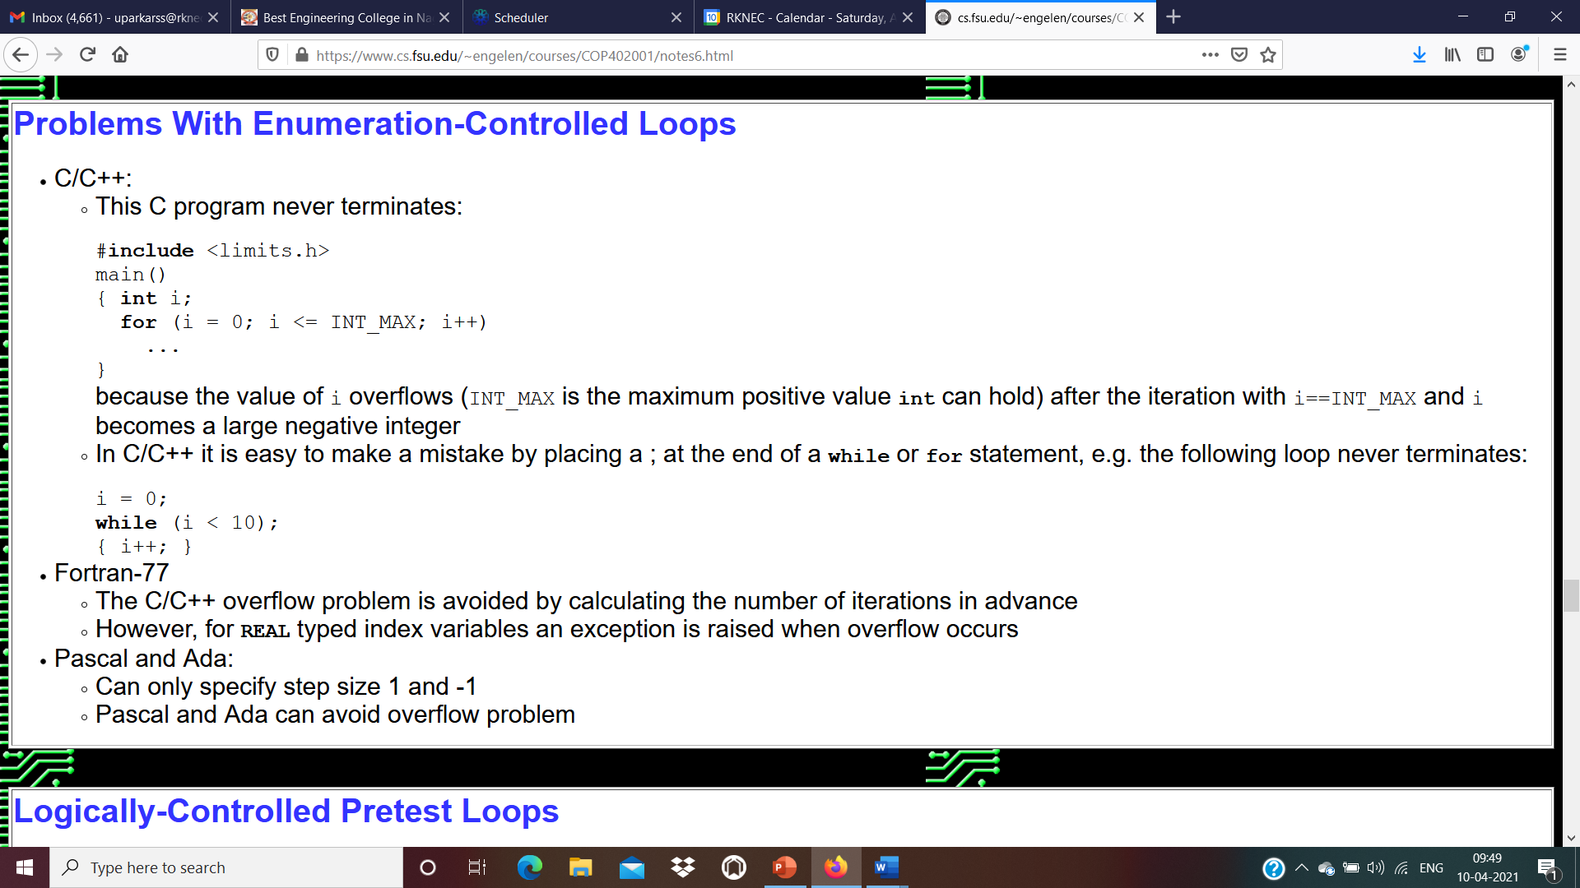

Slide 53
Control Flow
2. Logically Controlled Loops
In comparison to enumeration-controlled loops, logically controlled loops have many fewer semantic subtleties.
The familiar while loop syntax for this was introduced in Algol-W: Ex: While loop in Pascal
while condition do statement
To allow the body of the loop to be a statement list, most modern languages use an explicit concluding keyword (e.g., end), or bracket the body with delimiters (e.g., { . . . }). A few languages (notably Python) indicate the body with an extra level of indentation.

Slide 54
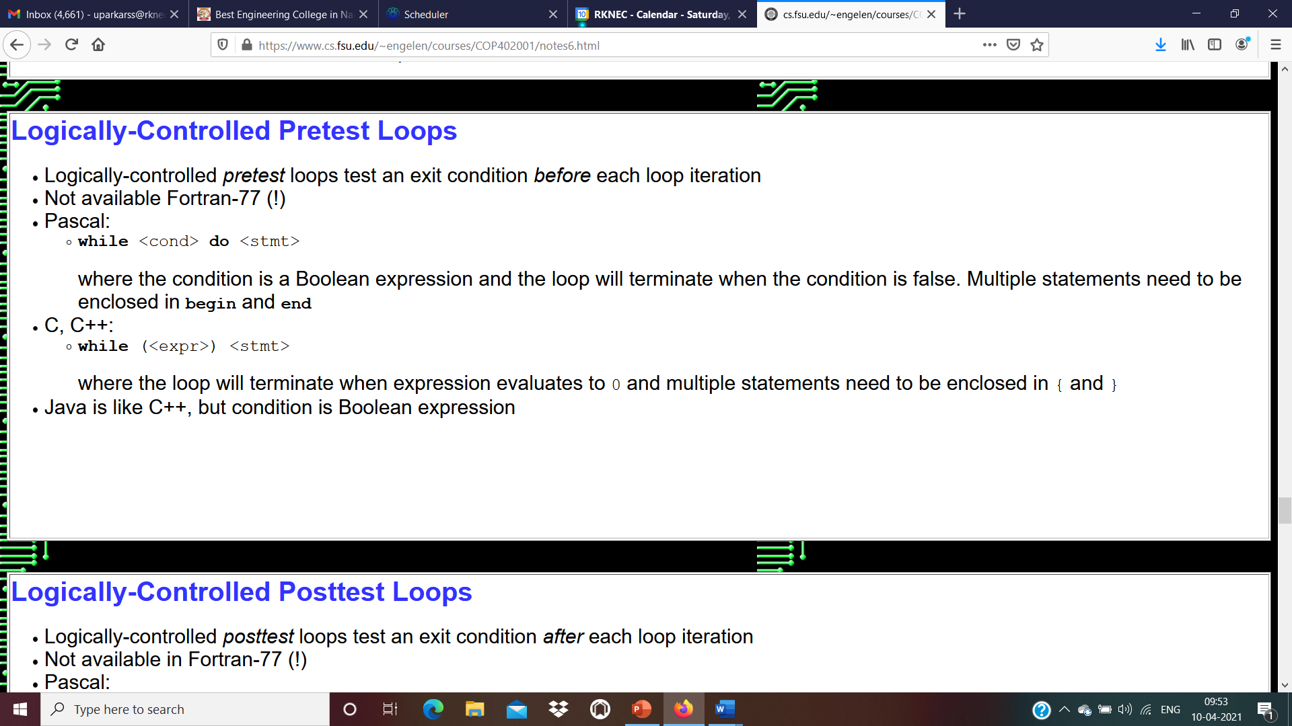
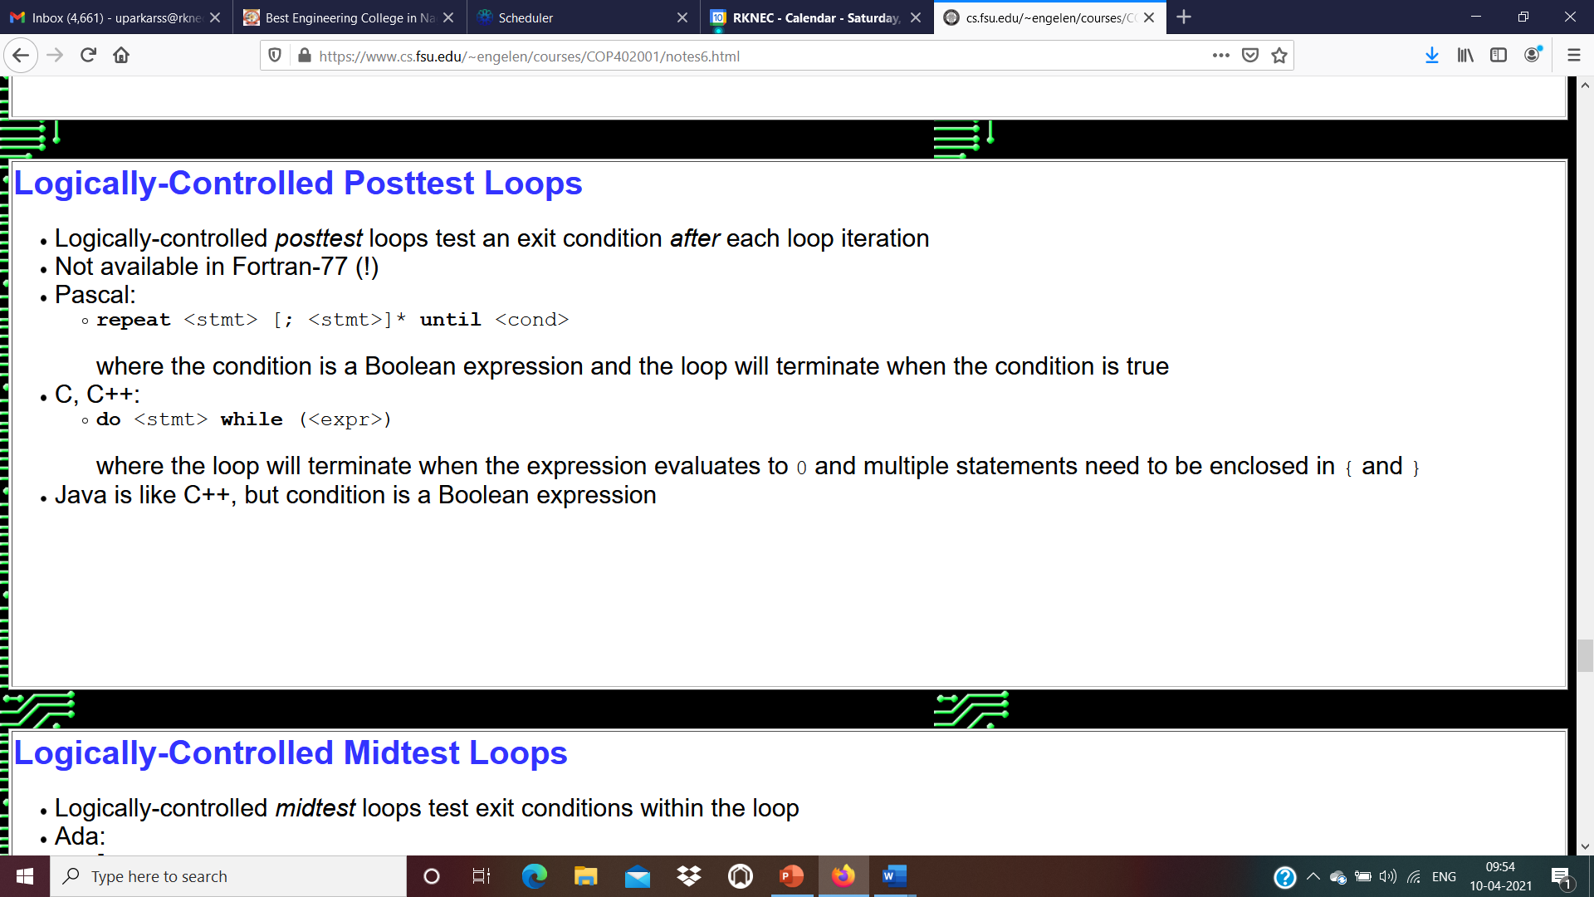

Slide 55
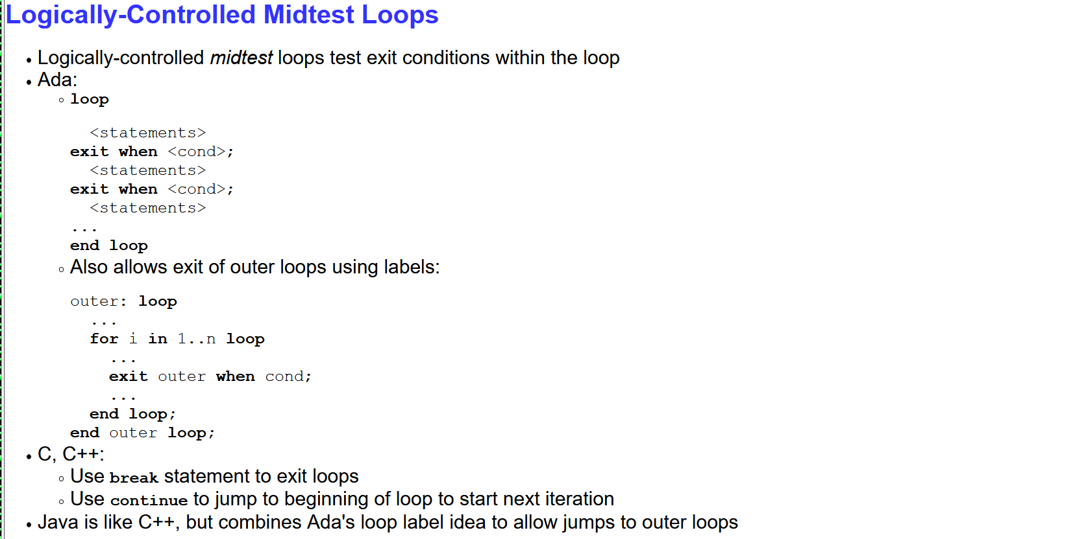

Slide 56
Activation Record Format
In a C/C++ program, multiple functions can be active at the same time. For example, suppose main calls f, which in turn calls g. Then while g is executing, main, f, and g are all active.
Each active function has an activation record, a chunk of computer memory which holds the arguments and “normal'' local variables of the function.

Slide 57
Temporaries : Expression is evaluated in it . All intermediates results are stored here.
Local Data: It stores the local variables.
Machine Status: Its holds the information about machine status before the procedure call. It is useful to send the control back to the address of caller, in case of rollback.
Access Link : In this section non local variable(s) is/are accessed.
Control link: It points to the activation records of the caller.
Actual Parameters: It holds the value of the actual parameters
Return value: Value to be returned is stored in this section.
Temporaries
Local Data
Machine Status
Access Link
Control Link
Parameters
Return Values
A General Activation Record Format

Slide 58
Control Flow
Recursion
Recursion requires no special syntax.
In any language that provides subroutines (particularly functions), all that is required is to permit functions to call themselves, or to call other functions that then call them back in turn.
Fortran 77 and certain other languages do not permit recursion. A few functional languages do not permit iteration.
Most modern languages, however, provide both mechanisms.

Slide 59
Defining a Recursive Function
Recursive Function – A function that is defined in terms of itself via self-referential expression
This means the function will continue to call itself and repeat tis behavior until some condition is met to return a result.
All recursive functions share a common structure made up of two parts:
1. Recursive case
Decompose original problem into simpler instances of the same problem
2. Base case
Smallest instance of the same problem.

Slide 60
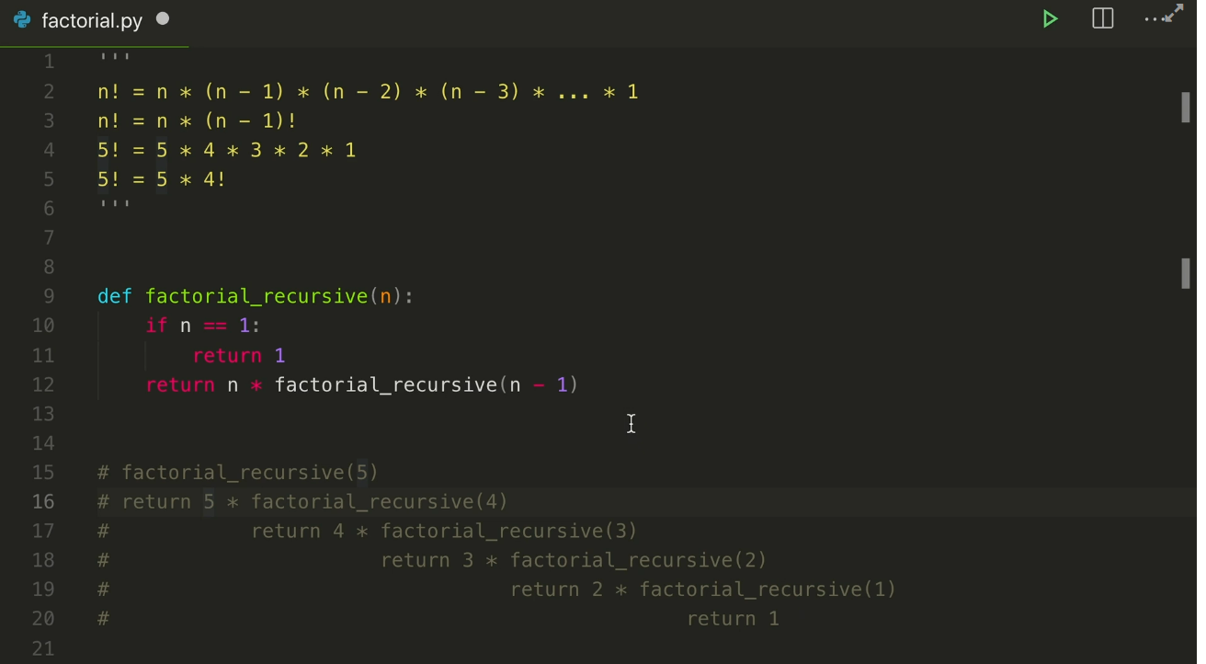

Slide 61


Slide 62
Types of Recursions
Direct Recursion
Indirect Recursion
Tail Recursion
Non Tail Recursion
( Note:Topic of Thinking Recursively)

Slide 63
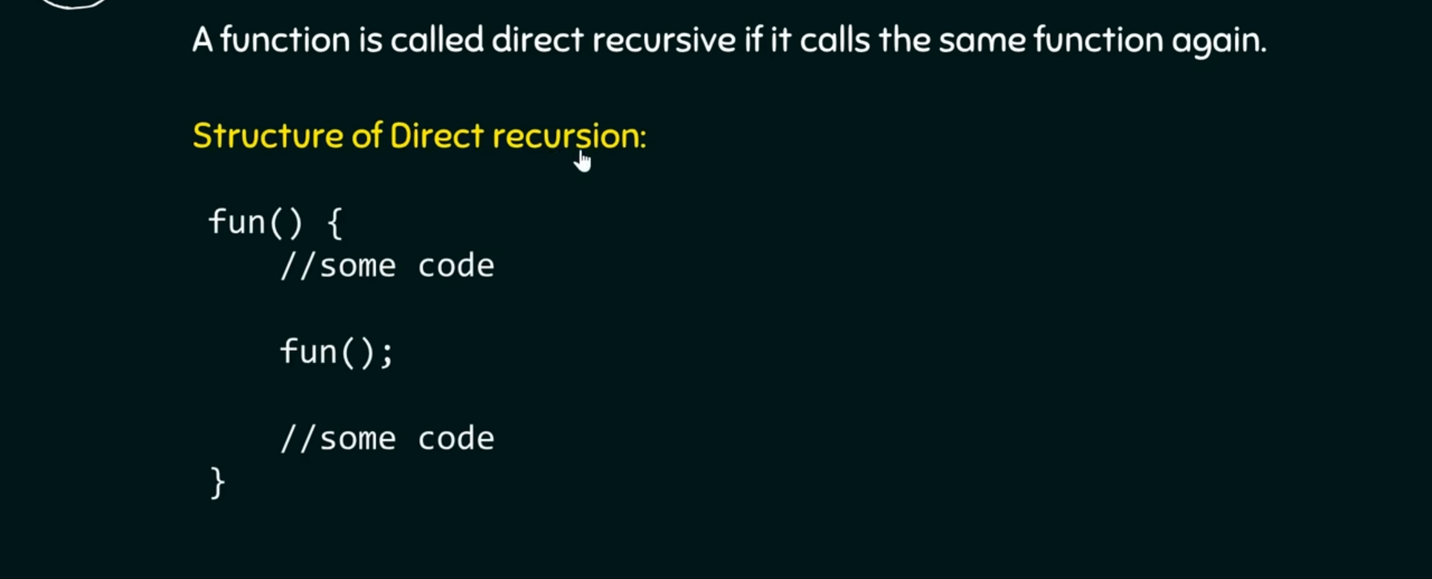
Direct Recursion

Slide 64
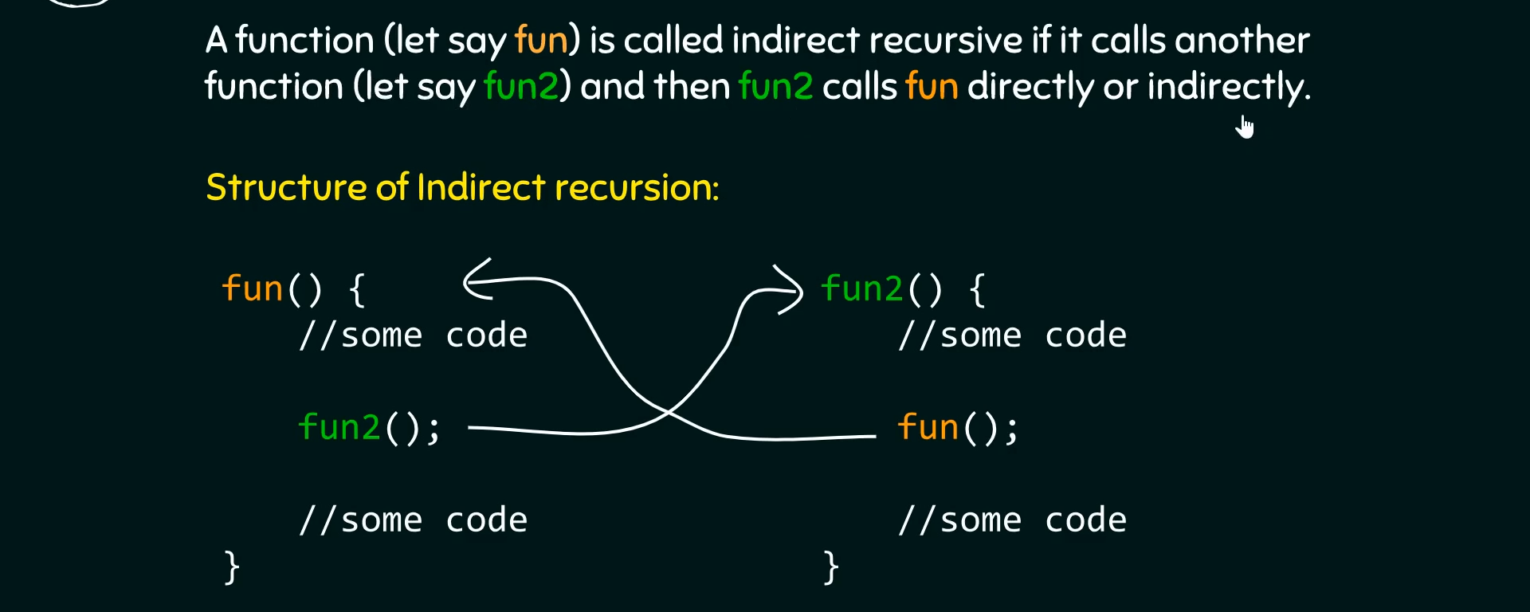
Indirect Recursion

Slide 65
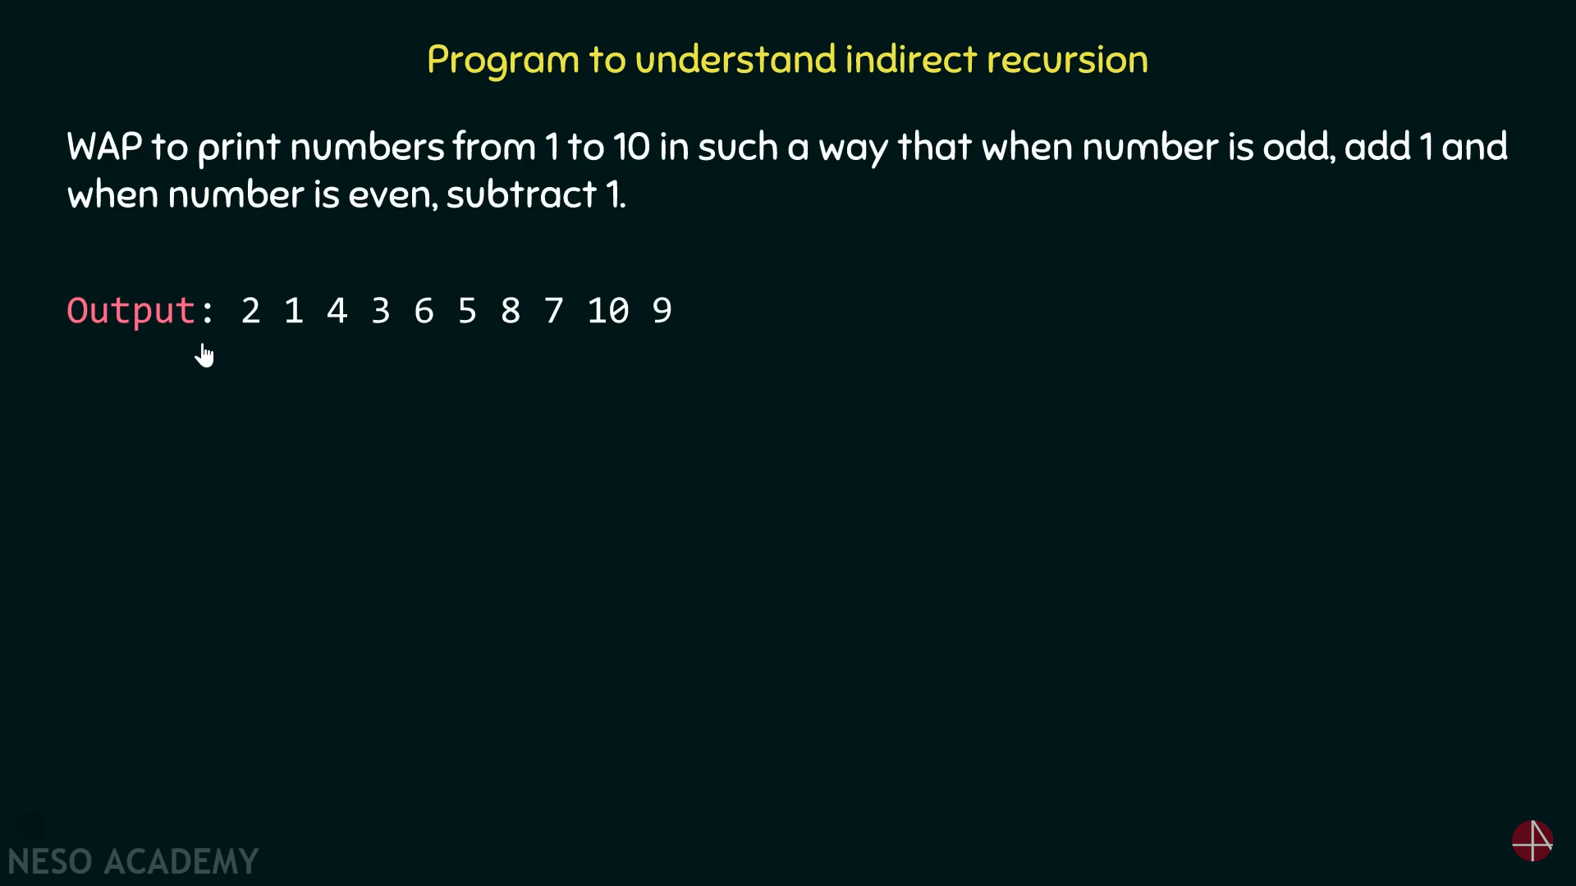
example

Slide 66
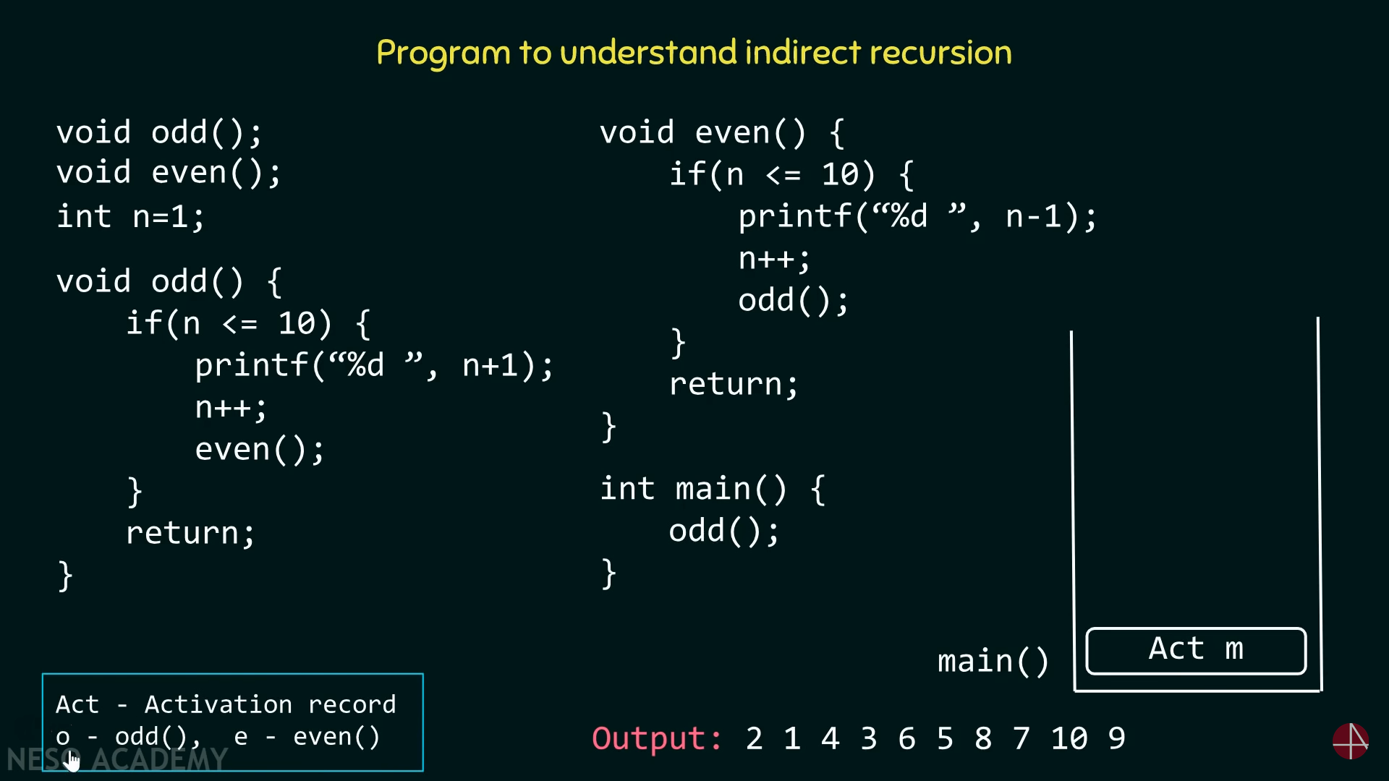
example

Slide 67
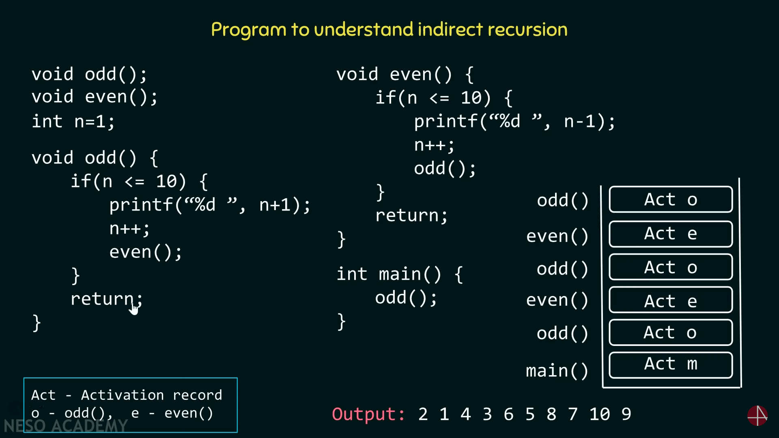
example

Slide 68
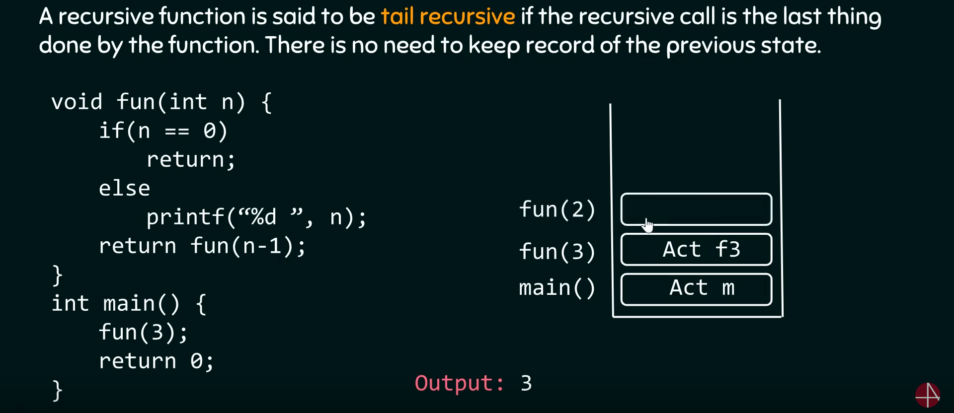
Tail Recursive

Slide 69
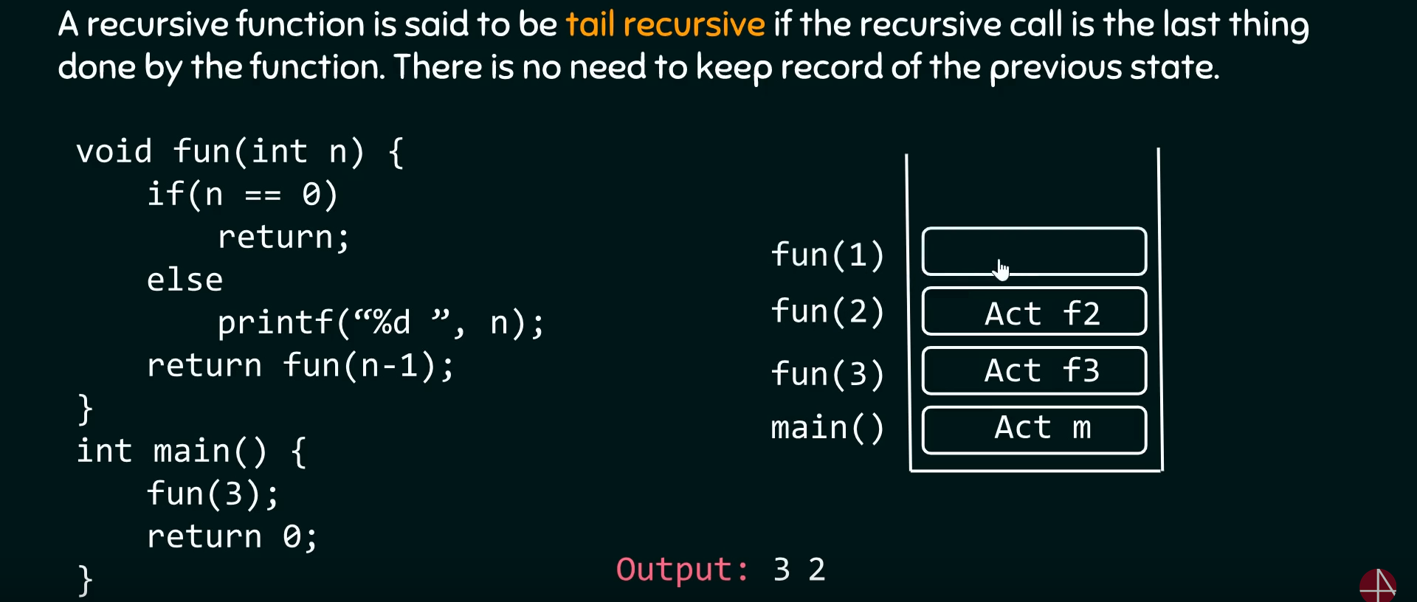
Tail Recursive

Slide 70
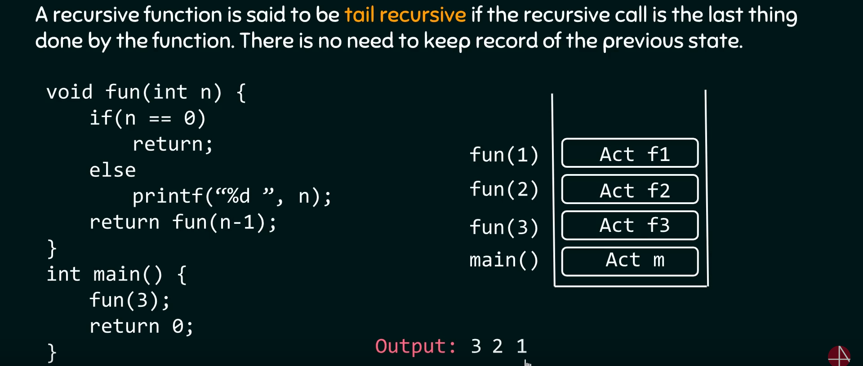
Tail Recursive

Slide 71
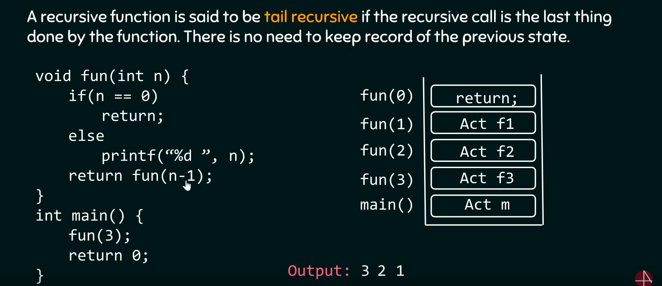
Tail Recursive

Slide 72
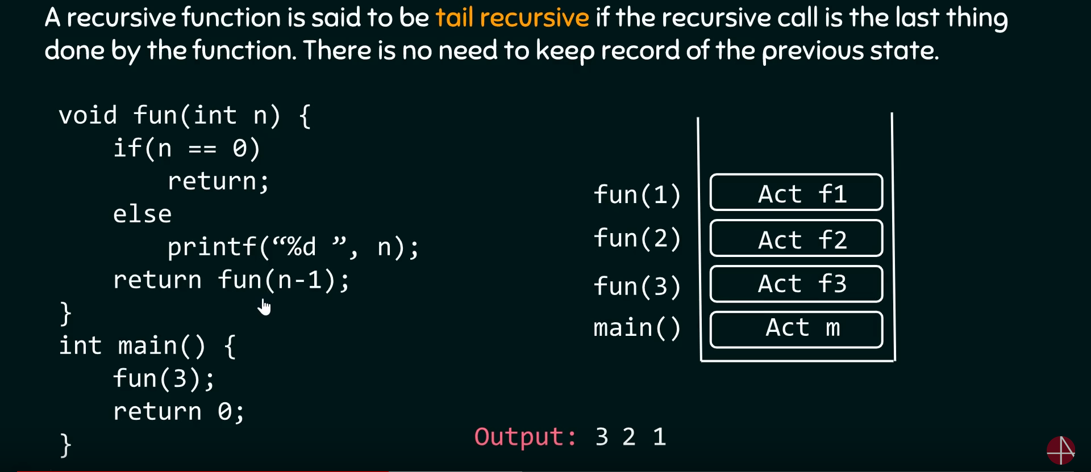
Tail Recursive

Slide 73
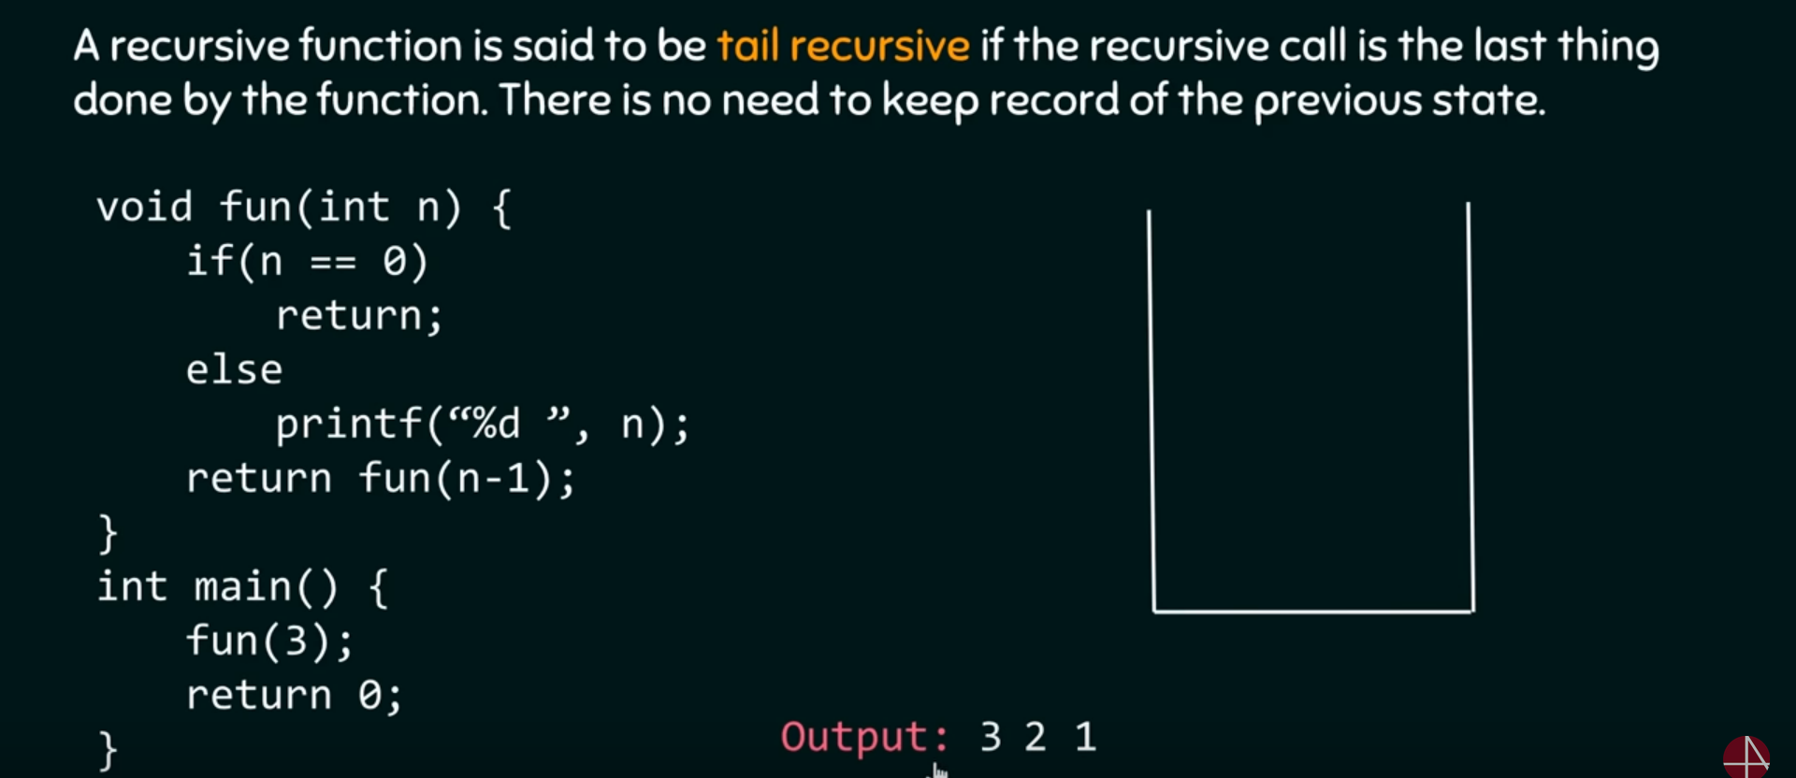
Tail Recursive

Slide 74
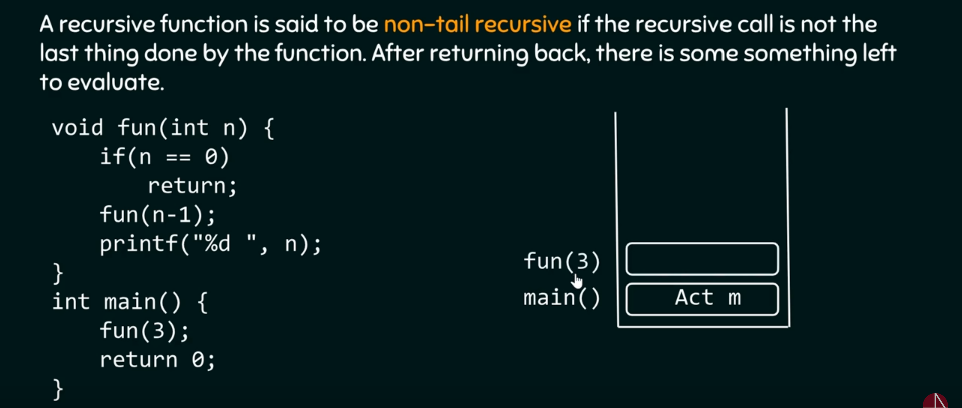
Non Tail Recursion

Slide 75
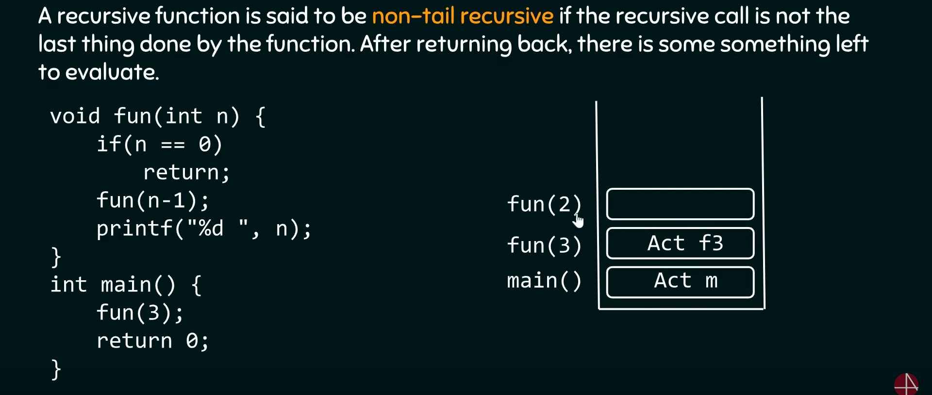
Non Tail Recursion

Slide 76
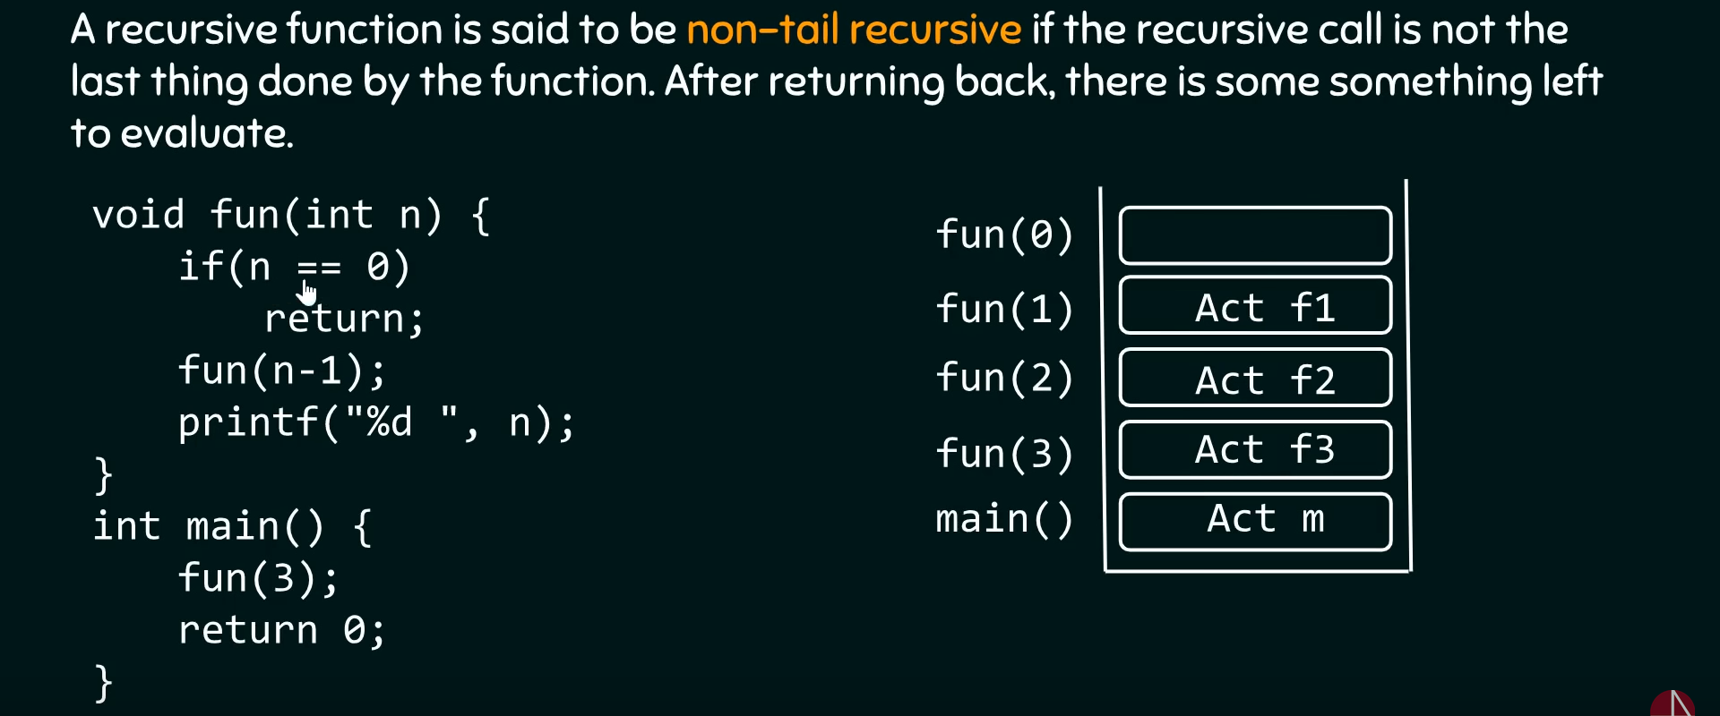
Non Tail Recursion

Slide 77
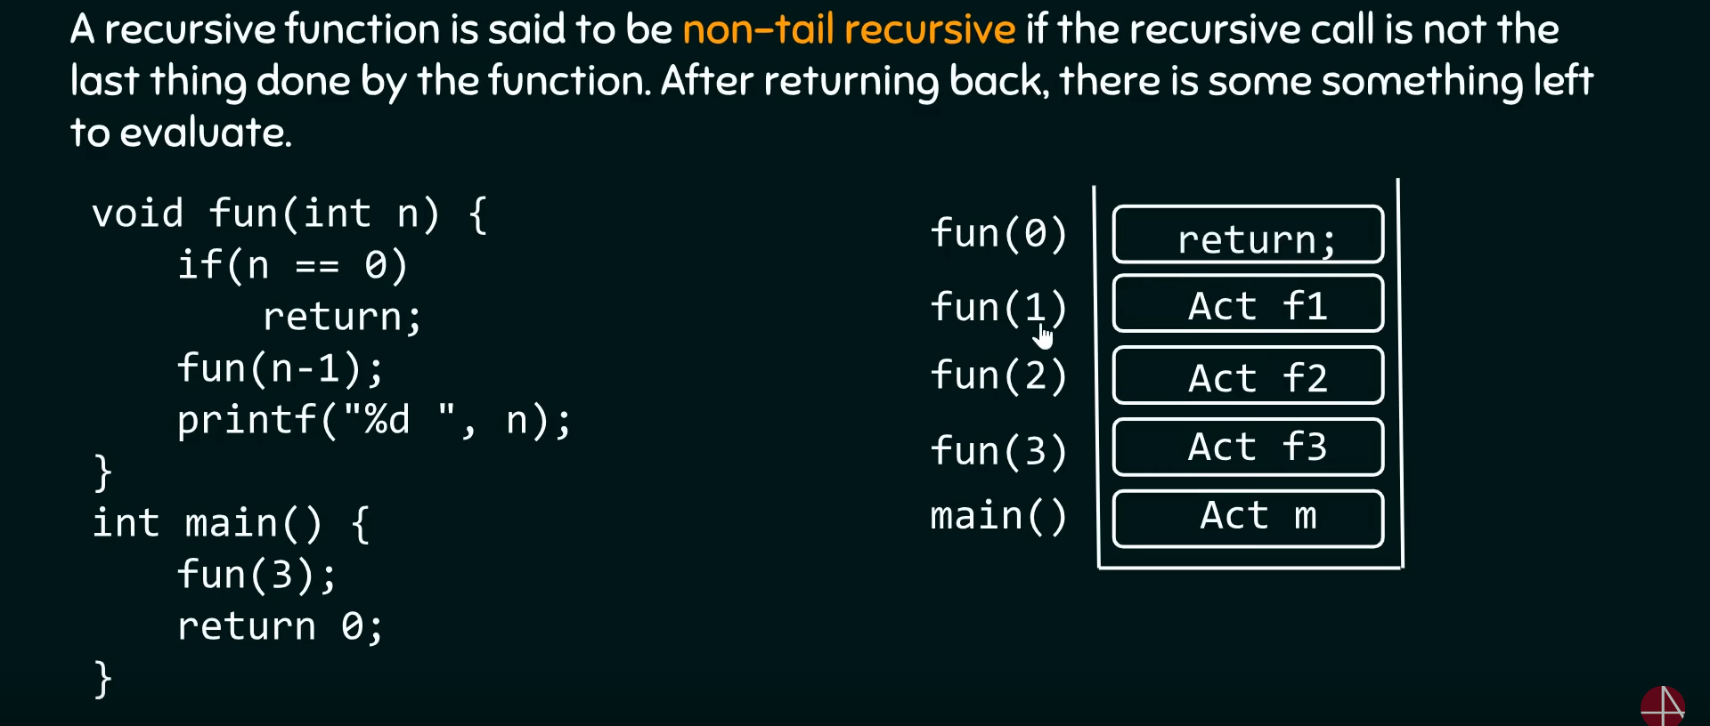
Non Tail Recursion

Slide 78
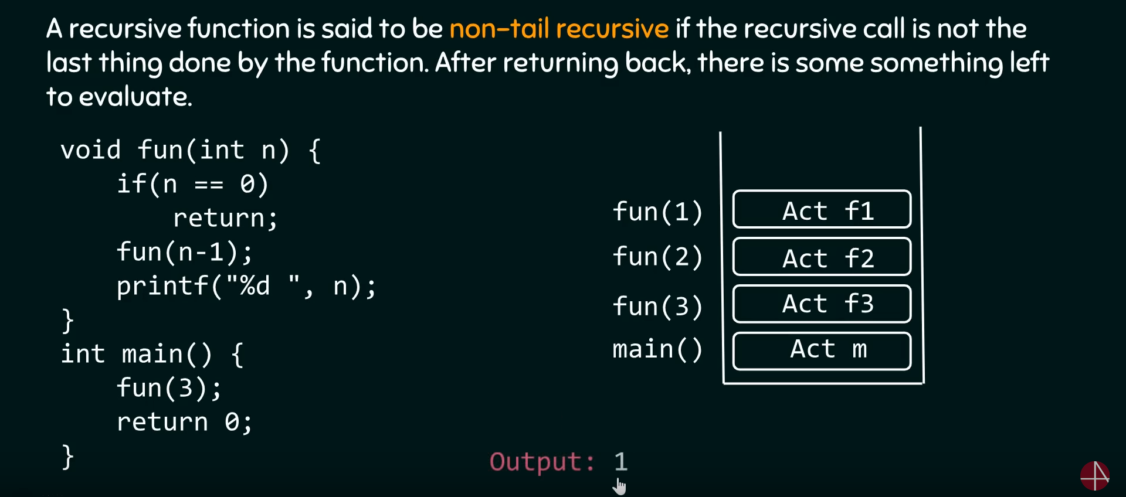
Non Tail Recursion

Slide 79
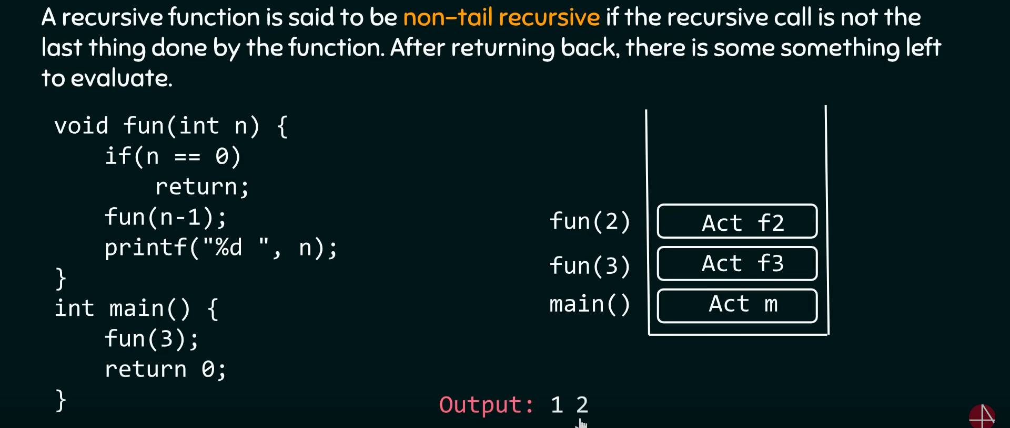
Non Tail Recursion

Slide 80
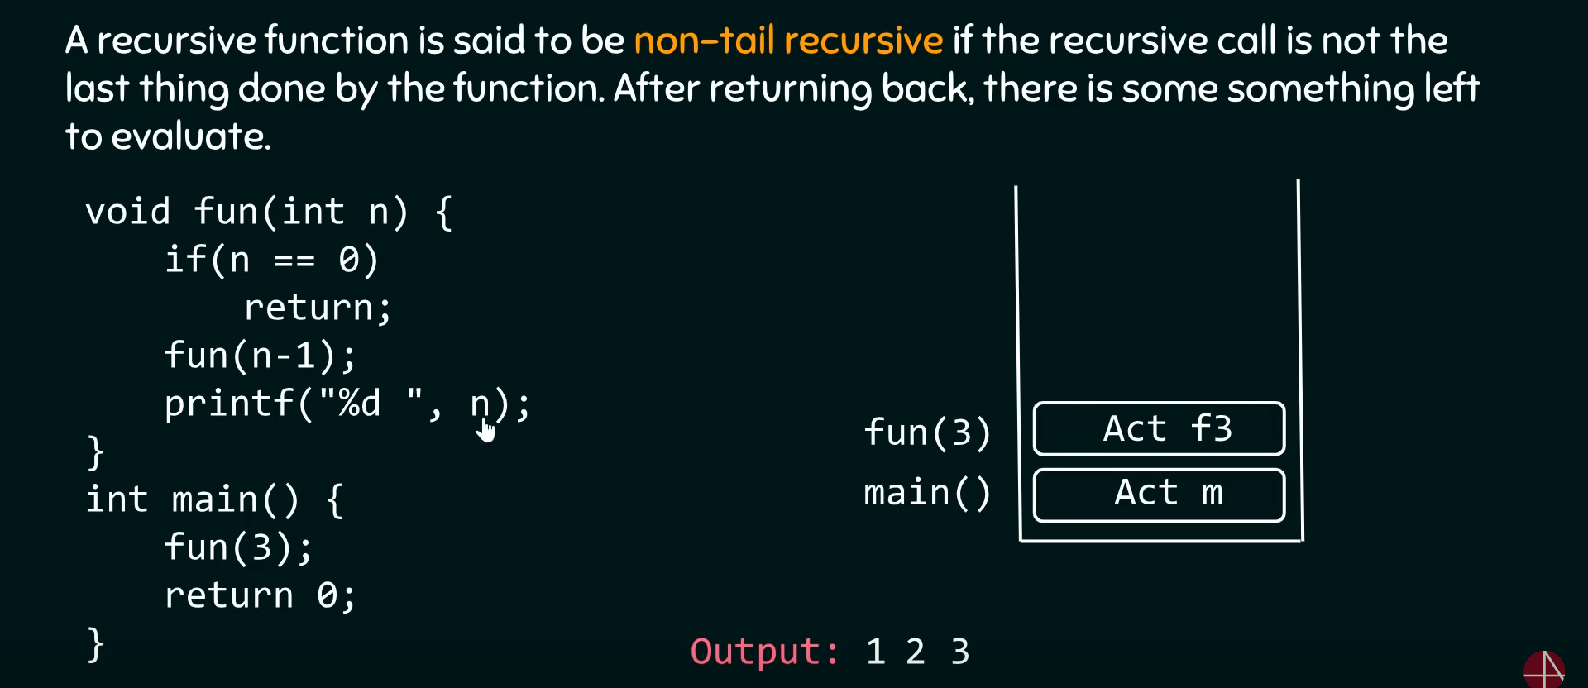
Non Tail Recursion

Slide 81
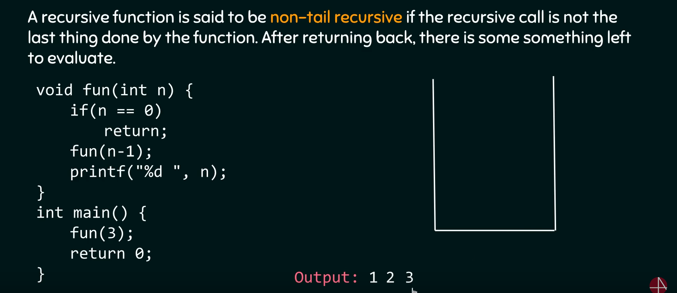
Continue..

Slide 82
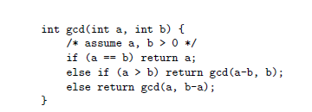
Book example
s

Slide 83
Control Flow
Tail Recursion
It is sometimes argued that iteration is more efficient than recursion.
It is more accurate to say that naive implementation of iteration is usually more efficient than naive implementation of recursion.
A tail-recursive function is one in which additional computation never follows a recursive call: the return value is simply whatever the recursive call returns.

Slide 84
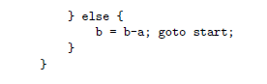
Control Flow
For such functions, dynamically allocated stack space is unnecessary: the compiler can reuse the space belonging to the current iteration when it makes the recursive call. In effect, a good compiler will recast the recursive gcd function above as follows.

Slide 85
Control Flow
C Example
// An example of tail recursive function
void print(int n)
{
if (n < 0) return;
cout << " " << n;
// The last executed statement is recursive call
print(n-1);
}
Java Example
// An example of tail recursive function
static void print(int n)
{
if (n < 0)
return;
System.out.print(" " + n);
// The last executed statement
// is recursive call
print(n - 1);
}

Slide 86
Control Flow
The tail recursive functions considered better than non tail recursive functions as tail-recursion can be optimized by compiler.
The idea used by compilers to optimize tail-recursive functions is simple, since the recursive call is the last statement, there is nothing left to do in the current function, so saving the current function’s stack frame is of no use

Slide 87
Control Flow
non-tail recursive function
Consider the following function to calculate factorial of n. It is a non-tail-recursive function. Although it looks like a tail recursive at first look.
If we take a closer look, we can see that the value returned by fact(n-1) is used in fact(n), so the call to fact(n-1) is not the last thing done by fact(n)

Slide 88
Control Flow
#include<iostream>
using namespace std;
// A NON-tail-recursive function. The function is not tail
// recursive because the value returned by fact(n-1) is used in
// fact(n) and call to fact(n-1) is not the last thing done by fact(n)
unsigned int fact(unsigned int n)
{
if (n == 0) return 1;
return n*fact(n-1);
}
// Driver program to test above function
int main()
{
cout << fact(5);
return 0;
}
Output :
120

Slide 89
Control Flow
The function can be written as a tail recursive function. The idea is to use one more argument and accumulate the factorial value in second argument. When n reaches 0, return the accumulated value.
#include<iostream>
using namespace std;
// A tail recursive function to calculate factorial
unsigned factTR(unsigned int n, unsigned int a)
{
if (n == 0) return a;
return factTR(n-1, n*a);
}
// A wrapper over factTR
unsigned int fact(unsigned int n)
{
return factTR(n, 1);
}
// Driver program to test above function
int main()
{
cout << fact(5);
return 0;
}

Slide 90
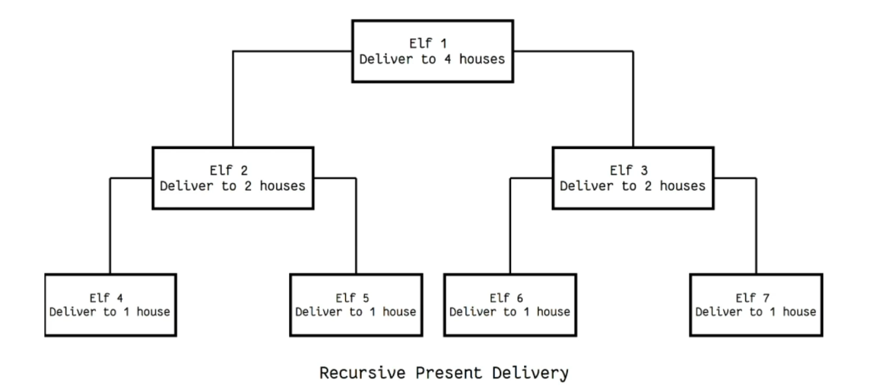
Control Flow
Thinking Recursively
Detractors of functional programming sometimes argue, incorrectly, that recursion leads to algorithmically inferior programs.

Slide 91
Control Flow
References:
Michael L. Scott, “Programming Language Pragmatics”, Morgan Kaufmann Publishers.
[Chapter 6: 6.1, 6.3 , 6.4.1,6.4.2]

Slide 92
CHECK YOUR UNDERSTANDING
Given the ability to assign a value into a variable, why is it useful to be able to specify an initial value?
What are aggregates? Why are they useful?
Explain the notion of definite assignment in Java and C#.
Why is it generally expensive to catch all uses of uninitialized variables at run time?
Why is it impossible to catch all uses of uninitialized variables at compile time?
Why do most languages leave unspecified the order in which the arguments of an operator or function are evaluated?
What is short-circuit Boolean evaluation?Why is it useful?

Slide 93
Control Flow
s

Slide 94


https://www.cs.fsu.edu/~engelen/courses/COP402001/notes6.html

